Slide 1


Produced by:
MSC Performance Group
Operations and Engineering Department
Vodafone Egypt
GSM System Survey

Slide 2

Contents
Chapter 1 : Introduction
Chapter 2 : Basic GSM Network Structure
Chapter 3 : Transmission System
Chapter 4 : Radio Coverage
Chapter 5 : Radio Problems and digital information
Chapter 6 : Air interface
Chapter 7 : Traffic Cases
Chapter 8 : GSM Services

Slide 3
Questions ?

Slide 4

Banner Advertisement. America 1929
Chapter 1 : Introduction

Slide 5

Chapter Objectives
Introduction
GSM System Survey
By the End of this Chapter you will:
Know the History of Telecommunications
Know the history of GSM evolution
Know about different GSM Phases

Slide 6
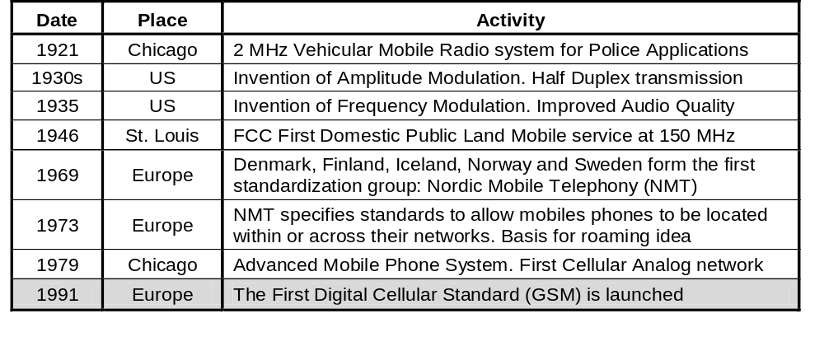
History of Wireless Communication
Introduction
GSM System Survey

Slide 7
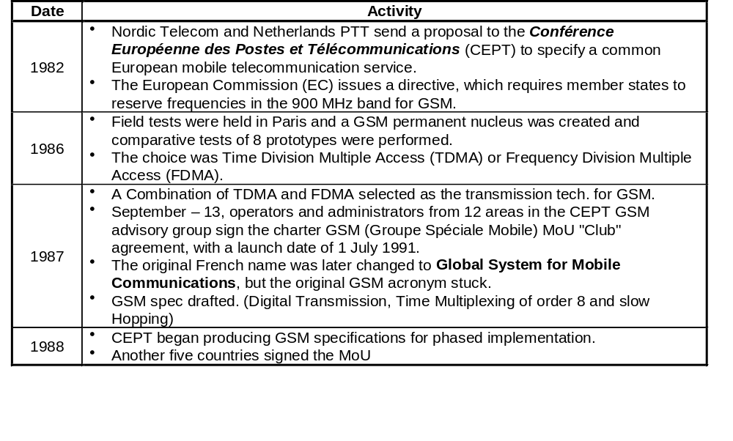
History of GSM
Introduction
GSM System Survey

Slide 8
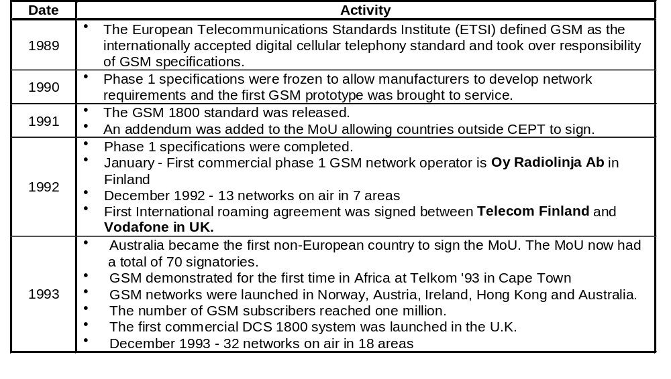
History of GSM
Introduction
GSM System Survey

Slide 9
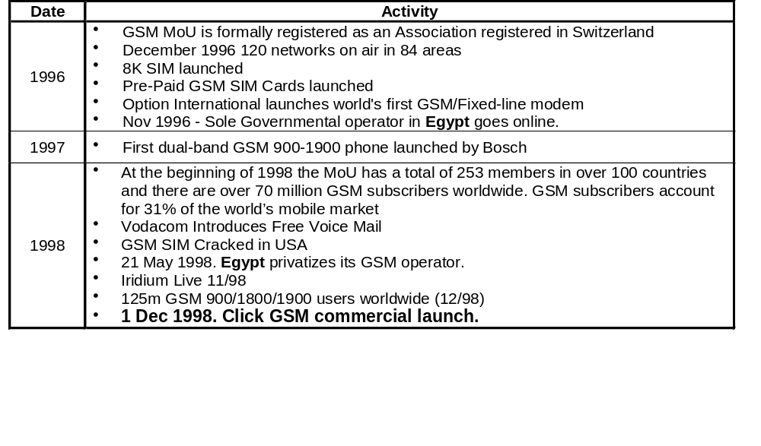
History of GSM
Introduction
GSM System Survey

Slide 10
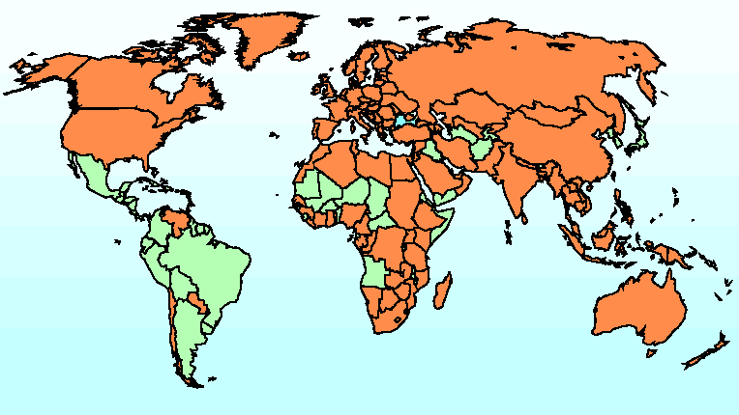
GSM Coverage worldwide
Introduction

Slide 11
Questions ?

Slide 12

Chapter 2 : GSM Network Elements
We hear Music .. But we don’t see the musicians ..

Slide 13
Chapter Objectives
Basic GSM Network Structure
GSM System Survey
By the End of this Chapter you will:
Know the role of the Basic nodes that compose the GSM network
Know how they are interconnected together
Know the different Identities used in GSM World

Slide 14


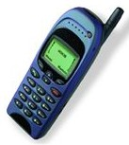
Basic GSM Network Structure
VLR
HLR
AUC
GSM System Survey
Basic GSM Nodes
BTS
BSC
MSC
Other Switching Nodes
Radio Interface
GW of another network
PSTN
Another MSC
ISDN
MS

Slide 15
Basic GSM Network Structure
GSM System Survey
The Mobile Services Switching Center (MSC)
Administers its Base Station Controller(s) BSC(s).
Switches calls to/from mobile subscribers.
Records charging and accounting details.
Provides the gateway functionality to other networks.

Slide 16
Basic GSM Network Structure
GSM System Survey
The Home Location Register (HLR)
Controls the routing of mobile terminated calls and SMS.
Stores for each mobile subscriber:
Basic subscriber categories.
Supplementary services.
Current location(MSC address).
Allowed/barred services.
Authentication data.

Slide 17
Basic GSM Network Structure
GSM System Survey
Triplets
Authentication Center
RAND
SRES
Kc
Triplet
Home Location Register
RAND
SRES
Kc
Triplet
Visitor Location Register
RAND
SRES
Kc

Slide 18

Basic GSM Network Structure
GSM System Survey
Producing Triplets
Authentication Algorithm
A3
SRES
SRES
Ki
RAND
Random Number Generator
RAND
RAND
IMSI
Ki
RAND
Ki
Ciphering Algorithm
A8
Kc
Kc

Slide 19
Basic GSM Network Structure
GSM System Survey
The Authentication Procedure
Visitor Location Register
Rand
SRES _{AUC}
Kc
SRES _{AUC}
=
SRES _{MS}
Access
Barred
Base Station Subsystem
Rand
SRES _{MS}
Kc
SIM Card
SRES _{MS}
Rand
A3
Ki
Rand
A8
Kc

Slide 20
Basic GSM Network Structure
GSM System Survey
The Ciphering Procedure
To the BSC
From the BSC
DATA
DATA
Base Transceiver Station
Decryption
Algorithm
Kc
TDMA
Frame Number
Encryption
Algorithm
Encrypted DATA
Air Interface
Encrypted DATA
Mobile Station
Encryption
Algorithm
Kc
TDMA
Frame Number
Decryption
Algorithm
DATA
DATA

Slide 21
Basic GSM Network Structure
GSM System Survey
The Visitor Location Register (VLR)
It stores a copy of the HLR Profile for all currently registered mobile subscribers who are covered by cells belonging to the MSC coverage area.
The VLR is always integrated with the MSC.
The VLR stores the Location area of the MS (which is not stored in the HLR).

Slide 22
Basic GSM Network Structure
GSM System Survey
The Base Station Controller (BSC)
Manages the Radio Communication with the mobile station over the
air interface.
Controls the handover of calls in progress Between BTSs
Supervises the transmission network and the operation of each BTS

Slide 23
Basic GSM Network Structure
GSM System Survey
The Base Transceiver Station (BTS)
Consists of the radio transmitters, receivers and the antenna system required to provide the coverage area for one cell.
Converts the GSM radio signals into a format that can be recognized by the BSC.
Records and passes to the BSC the Signal strength measurements.
Performs the network end of the ciphering/encryption process.

Slide 24
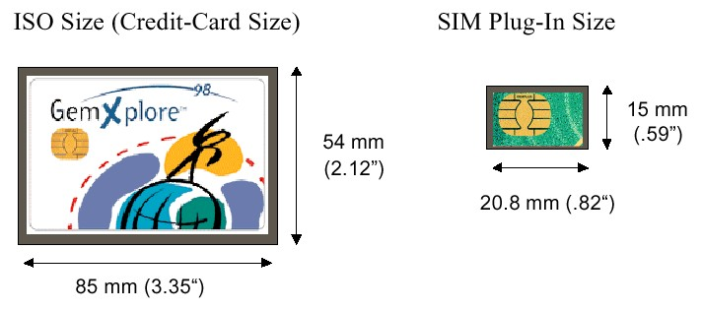
Basic GSM Network Structure
GSM System Survey
+
The Mobile Station (MS)
The Mobile Equipment is said to be a Mobile Station if the Subscriber Identity Module ( SIM Card ) is added to it
The SIM Card contains:
A processor and memory.
that stores:
- The international mobile subscriber Identity
IMSI
- The Authentication and ciphering keys.

Slide 25
Basic GSM Network Structure
GSM System Survey
GSM Identities
Mobile Station ISDN Number (MSISDN)
20
CC
10
NDC
1100477
SN
44
CC
385
NDC
196099
SN
VodaFone Egypt MSISDN
VodaFone UK MSISDN
CC : Country Code
NDC : Network Destination Code
SN : Subscriber Number

Slide 26
Basic GSM Network Structure
GSM System Survey
GSM Identities
International Mobile Subscriber Identity (IMSI)
234
MCC
15
MNC
1234567890
MSIN
602
MCC
02
MNC
1234567890
MSIN
Vodafone UK IMSI
Vodafone Egypt IMSI
MCC : Mobile Country Code
MNC : Mobile Network Code
MSIN : Mobile Station Identification Number

Slide 27
Basic GSM Network Structure
GSM System Survey
GSM Identities
International Mobile Equipment Identity (IMEI)
Final Assembly Codes (FAC)
01,02 AEG
07,40 Motorola
10,20 Nokia
30 Ericsson
40,41,44 Siemens
47 Optional International
50 Bosch
51 Sony
51 Siemens
51 Ericsson
60 Alcatel
70 Sagem
75 Dancall
80 Philips
85 Panasonic
6 Digits
TAC
2 Digits
FAC
6 Digits
SN
IMEI
TAC: Type Approval Code,
The first two digits are the
code for the country
approval
SN: Serial Number

Slide 28
Basic GSM Network Structure
GSM System Survey
GSM Identities
Temporary Mobile Subscriber Identity Number (TMSI)
The TMSI can be allocated to the mobile subscriber in order to be used instead of his IMSI during all radio communications. The purpose is to keep subscriber information confidential on the air interface.
The TMSI is relevant on the local MSC/VLR level only and is changed at certain events or time intervals. Each local operator can define its own TMSI structure.

Slide 29
Basic GSM Network Structure
GSM System Survey
GSM Identities
Mobile Station Roaming Number (MSRN)
When a mobile terminating call is to be set-up, the HLR of the called subscriber requests the MSC/VLR to allocate an MSRN to the called subscriber.
This MSRN is returned via the HLR to the GMSC.
The GMSC routes the call to the MSC/VLR exchange where the called subscriber is currently registered.
The routing is done using the MSRN. When the routing is completed, the MSRN is released.
The interrogation call routing function (request for MSRN) is part of the MAP.
All data exchanged between GMSC-HLR-MSC/VLR for the purpose of interrogation is sent over S7 signaling.
The MSRN is built up like an MSISDN.

Slide 30
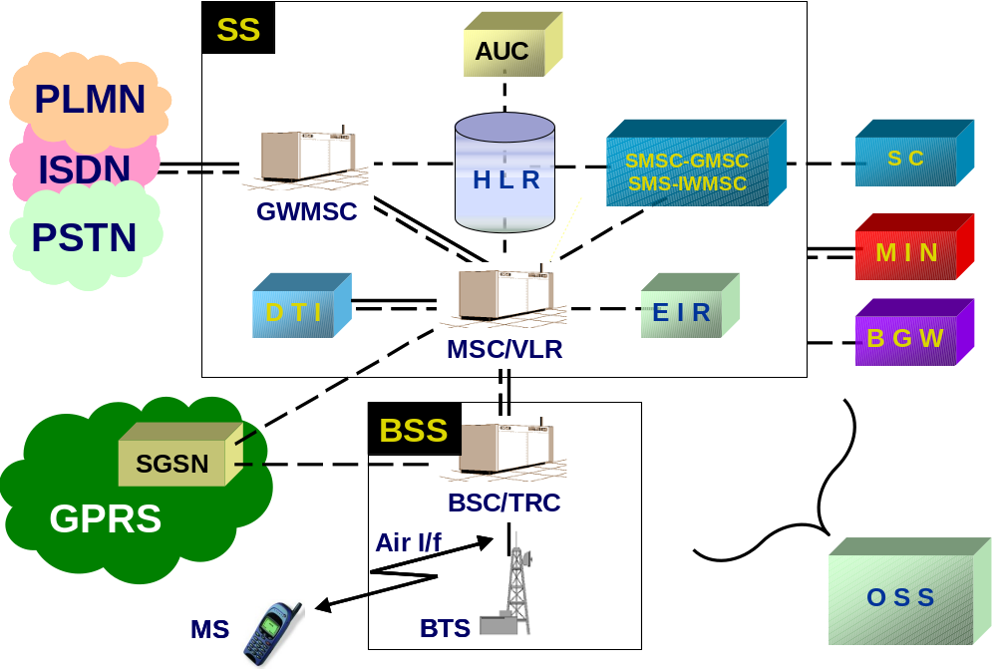
Basic GSM Network Structure
GSM System Survey
GSM Network Structure

Slide 31
Basic GSM Network Structure
GSM System Survey
Vodafone Egypt Network Structure
HORUS
OSIRIS
ISIS
OPET
SETH
HATHOR
AMUN
THOTH
NEFTIS
NUN
MINA
BTAH
ABIS
SEKHMET
NEITH

Slide 33
Questions ?
GSM System Survey

Slide 34
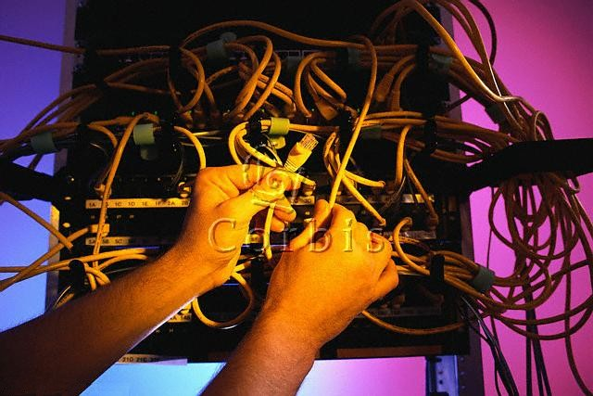
Chapter 3 : Transmission System
We mean by a transmission system, how the nodes are interconnected

Slide 35
Chapter Objectives
Transmission System
GSM System Survey
By the End of this Chapter you will:
Know How do we use TE infrastructure in connecting our Nodes
Know the basic role of the DXX

Slide 36
Transmission System
GSM System Survey
Review the System
HLR
BTS
BSC
MSC/VLR
Another Switching Node
Radio Interface
GW Of another network
PTT
MS
PABX
Another MSC

Slide 37
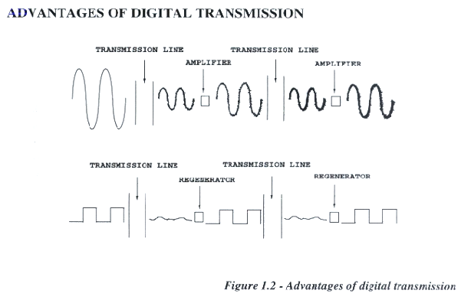
Radio Coverage
GSM System Survey
Digital Versus Analog Transmission
Digital Communication offers better noise performance

Slide 38
Transmission System
Misrfone Switch
TE Adjacent Switch
GSM System Survey
RBLT
S
T
M
BSC
TE Fiber Backbone
Synchronous
Transport Module
155 Mb/sec
2 Mb/sec
DDF
ADM
B/B Con.
Digital Distribution
Frame
Ramsis PTT
Aswan
PTT
TE Fiber
Backbone
SDH
Alex
PTT
2 Mb/sec
Suez
PTT
DDF
ADM
Add / Drop
Multiplexer

Slide 39
Transmission System
GSM System Survey
Transmission system
Ramsis PTT
RBLT
BSC
SDH
2 Mb/sec
DDF
Misrfone
Switch
DDF
TE Remote
PTT
0 | 1 | 2 | .. | .. | .. | 29 | 30 | 31

Slide 40
Transmission System
GSM System Survey
Insufficient use of resources
Ramsis PTT
RBLT
BSC
DDF
Misrfone
Switch
DDF
0 | 1 | 2 | .. | .. | .. | 13 | 14 | 15
TE Remote
PTT
16 | 17 | .. | .. | .. | 28 | 29 | 31
0 | 1 | 2 | .. | .. | .. | 13 | 14 | 15

Slide 41
Transmission System
GSM System Survey
Introducing DXX
Ramsis PTT
RBLT
BSC
LDXX
DDF
Misrfone
Switch
DDF
HUB
TE Remote
PTT
RDXX

Slide 42
Questions ?
GSM System Survey

Slide 43

Break

Slide 44
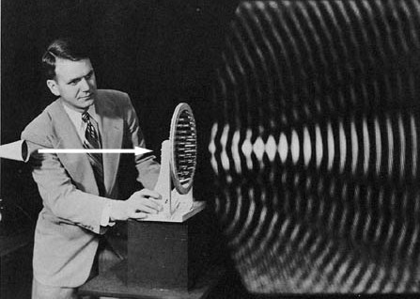
Chapter 4 : Radio Coverage
A visible pattern of sound waves

Slide 45
Chapter Objectives
Radio Coverage
GSM System Survey
By the End of this Chapter you will:
Know The Geometrical Theoretical shape of the cells
Know the frequency band allocated for GSM
Know what is meant by frequency Reuse
Know when to use different cluster sizes

Slide 46
Radio Coverage
GSM System Survey
Cell Geometry
Dead Spots
Problem of omni directional antennas

Slide 47
Radio Coverage
GSM System Survey
Cell Geometrical Shape
To solve the dead spot problem
R
R
R
Tradeoffs
The number of cells required to cover a given area.
The cell transceiver power.

Slide 48
Radio Coverage
GSM System Survey
Transceiver Antenna
Sectorial Antenna
Omni-Directional Antenna

Slide 49
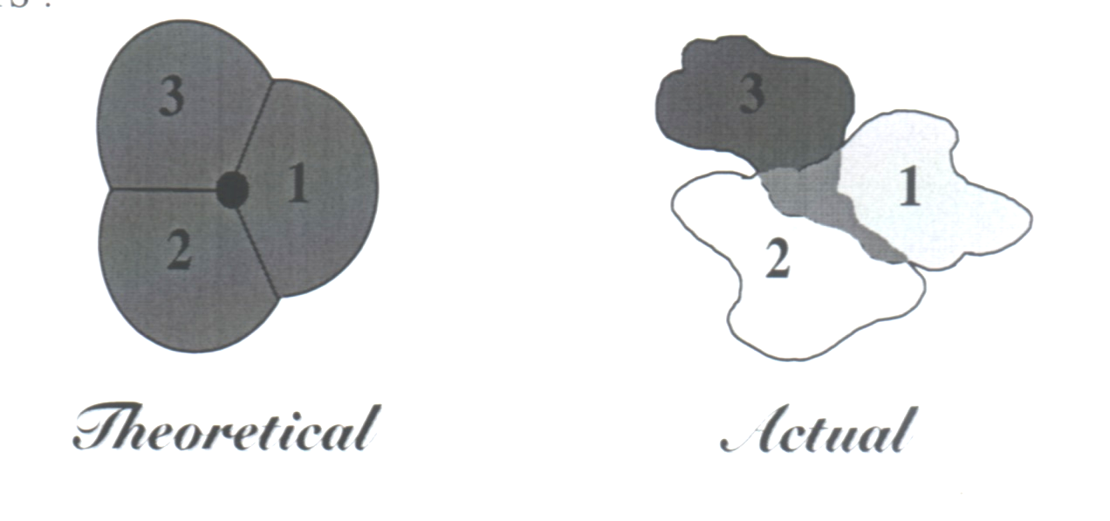
Radio Coverage
GSM System Survey
Sectorial Antenna
Sectorial Antenna
The cells will take the form of overlapping circles.
Due to the obstacles in the coverage area the actual shape of the
cells would be Random.

Slide 50
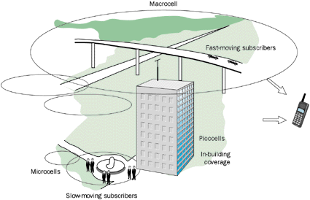
Radio Coverage
GSM System Survey
Cell Classification
Macrocell
Umbrella Cell
Overlaid &
Underlaid Cells
Fast moving subscribers
Normal Cell
Normal Cell
Picocell
In building
coverage
Microcell
Slow moving subscribers

Slide 51
Radio Coverage
GSM System Survey
GSM Coverage Plan
To provide coverage for a large service area of a mobile network we have two Options:
(A) Install one transceiver with high radio power at the center of the service area
(B) Divide the service area into smaller areas (cells)
Drawbacks
Advantages
The mobile equipments used in this network should have high output power in order to be able to transmit signals across the coverage area.
Each cell as well as the mobile handsets will have relatively small power transceivers.
The usage of the radio resources would be limited.
The frequency spectrum might be “reused” in two far separated cells. This yields:
Unlimited capacity of the system.
Good interference characteristics

Slide 52

Radio Coverage
GSM System Survey
Spectrum Allocation (GSM 900)
Downlink 935 – 960 MHz
Uplink 890 – 915 MHz
200 KHz
890.2
890.6
Uplink
1
1
2
3
4
121
121
122
123
124
890
890.4
915
F (MHz)
935.2
935.6
Downlink
1
121
1
2
3
4
121
122
123
124
935
935.4
960
F (MHz)
GSM 900 Frequency Allocation
ARFCN
Absolute Radio Frequency Channel Number

Slide 53
Radio Coverage
GSM System Survey
Spectrum Allocation (GSM 1800)
Downlink 1805 – 1880 MHz
Uplink 1710 – 1785 MHz
200 KHz
1710.2
1710.6
Uplink
1
2
3
4
371
372
373
374
1710
1710.4
1785
F (MHz)
1805.2
1805.6
Downlink
1
2
3
4
371
372
373
374
1805
1805.4
1880
F (MHz)
GSM 1800 Frequency Allocation

Slide 54
Comparison
Radio Coverage
GSM System Survey
1710
Uplink
1785
890
Uplink
915
95 MHz
45 MHz
GSM 1800
With 374 ARFCN
GSM 900
With 124 ARFCN
935
Downlink
960
25 MHz
1805
Downlink
1880
75 MHz

Slide 55
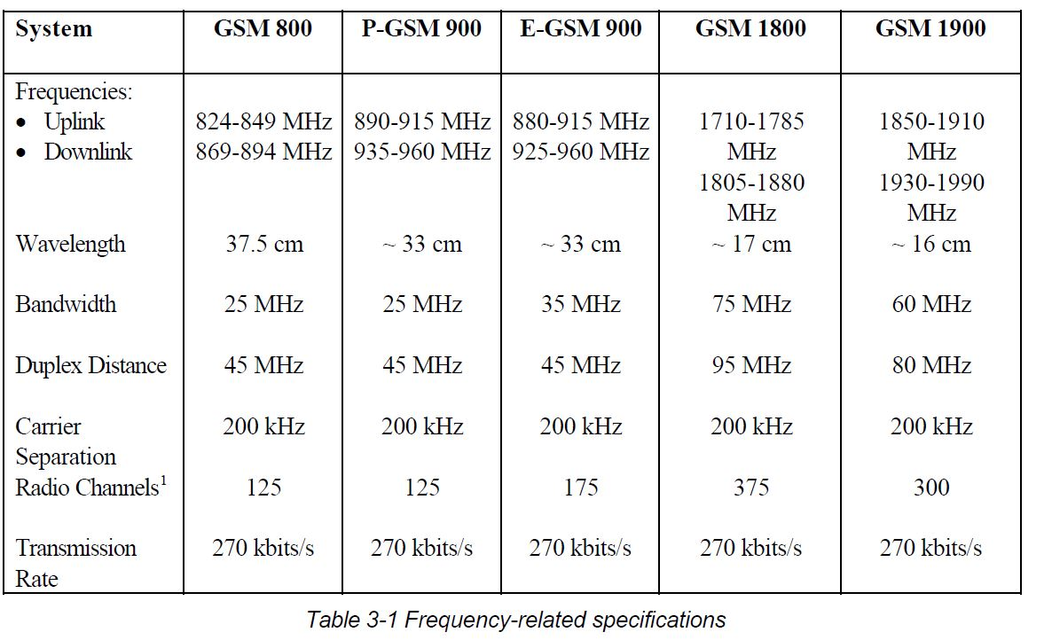

Slide 56
Radio Coverage
Frequency Reuse
GSM System Survey
Why do we need frequency reuse?
Total no of channels (frequencies) = 124
Every channel can be shared between a maximum of 8 subscribers.
Maximum no of simultaneous calls = 8 X 124 = 992 !!
The frequency reuse is performed by dividing the whole available frequencies between a group of neighboring cells which is called frequency reuse pattern or a “Cluster”, and then repeat this cluster over the whole network on 2 conditions:
The group of frequencies allocated to a given cell must not be used in the adjacent cells.
Enough distance between the cells where the same group of frequencies are reused.

Slide 57
Radio Coverage
3/9 Cluster
A3
B3
GSM System Survey
A2
B2
A1
B1
A3
B3
C3
A3
B3
A2
B2
C2
A2
B2
A1
B1
C1
A1
B1
A3
B3
C3
A3
B3
C3
A2
B2
C2
A2
B2
C2
A1
B1
C1
A1
B1
C1
C3
A3
B3
C3
A3
B3
C2
A2
B2
C2
A2
B2
C1
A1
B1
C1
A1
B1
A3
B3
C3
A3
B3
C3
A2
B2
C2
A2
B2
C2
A1
B1
C1
A1
B1
C1
C3
A3
B3
C3
A3
B3
3/9 cluster in which the available frequencies are divided into 9 groups and distributed between 3 sites
C2
A2
B2
C2
A2
B2
C1
A1
B1
C1
A1
B1
C3
C3
C2
C2
C1
C1

Slide 58
4 / 12 Cluster
Radio Coverage
GSM System Survey
A3
B3
A3
B3
A3
B3
A3
B3
A2
B2
A2
B2
A2
B2
A2
B2
A1
B1
A1
B1
A1
B1
A1
B1
C3
D3
C3
D3
C3
D3
C3
D3
C2
D2
C2
D2
C2
D2
C2
D2
C1
D1
C1
D1
C1
D1
C1
D1
A3
B3
A3
B3
A3
B3
A3
B3
A2
B2
A2
B2
A2
B2
A2
B2
A1
B1
A1
B1
A1
B1
A1
B1
C3
D3
C3
D3
C3
D3
C3
D3
C2
D2
C2
D2
C2
D2
C2
D2
C1
D1
C1
D1
C1
D1
C1
D1
A3
B3
A3
B3
A3
B3
A3
B3
A2
B2
A2
B2
A2
B2
A2
B2
A1
B1
A1
B1
A1
B1
A1
B1
C3
D3
C3
D3
C3
D3
C3
D3
C2
D2
C2
D2
C2
D2
C2
D2
C1
D1
C1
D1
C1
D1
C1
D1
4/12 cluster in which the available frequencies are divided into 12 groups and distributed between 4 sites

Slide 59
Radio Coverage
7 / 21 cluster in which the available frequencies are divided into 21 groups and distributed between 7 sites
A3
E3
GSM System Survey
A2
E2
A1
E1
B3
D3
F3
A3
E3
B2
D2
F2
A2
E2
B1
D1
F1
A1
E1
C3
G3
B3
D3
F3
A3
E3
C2
G2
B2
D2
F2
A2
E2
C1
G1
B1
D1
F1
A1
E1
A3
E3
C3
G3
B3
D3
F3
A2
E2
C2
G2
B2
D2
F2
A1
E1
C1
G1
B1
D1
F1
B3
D3
F3
A3
E3
C3
G3
B2
D2
F2
A2
E2
C2
G2
B1
D1
F1
A1
E1
C1
G1
C3
G3
B3
D3
F3
C2
G2
B2
D2
F2
C1
G1
B1
D1
F1
C3
G3
C2
G2
7 / 21 Cluster
C1
G1

Slide 60
Radio Coverage
Which Cluster Size to use?
GSM System Survey
Carrier to interference ratio
It’s the difference in power level between the carrier in a given
cell and the same carrier received from the nearest cell that reuses
the same frequency.
 | Number of frequencies per site | Traffic Channels | C/I Ratio
3/9 | High | High | Low
4/12 | Medium | Medium | Medium
7/21 | Low | Low | High

Slide 61
Questions ?
GSM System Survey

Slide 62
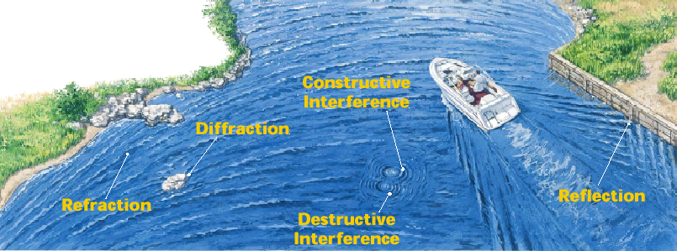
Chapter 5 : Radio problems & Digital Information

Slide 63
Chapter Objectives
By the End of this Chapter you will:
Know the Fading Problem and how it is Solved
Know the Time Dispersion Problem and how it is Solved
Know the Time Delay Problem and how it is Solved
Know how the Digital information is coded

Slide 64
Radio Problems and digital information
Fading Problems
GSM System Survey
1. Shadowing (Normal fading):
The reason for shadowing is the presence of obstacles like large hills or buildings in the path between the site and the mobile.
The signal strength received fluctuates around a mean value while changing the mobile position resulting in undesirable beats in the speech signal.
2. Rayleigh Fading (Multi-path Fading)
The received signal is coming from different paths due to a series of reflection on many obstacles. The difference in paths leads to a difference in paths of the received components.

Slide 65
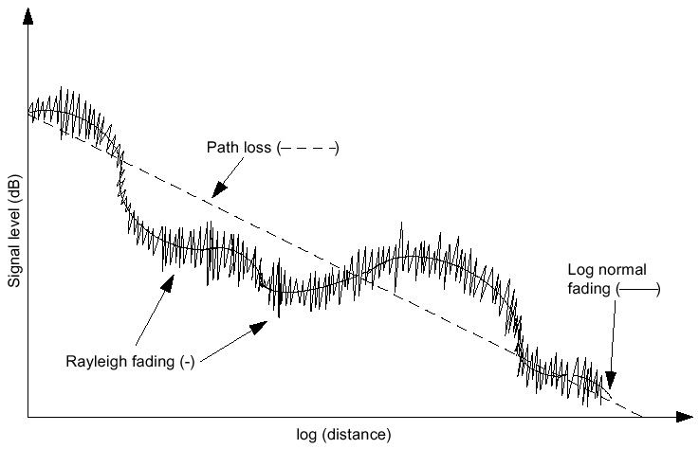
Radio Problems and digital information
Fading Problems
GSM System Survey

Slide 66
Radio Problems and digital information
Fading Problems Solutions
GSM System Survey
1. Increase the fading Margin
db
Fading Margin
Receiver
Sensitivity
time

Slide 67
Radio Problems and digital information
Fading Problems Solutions
GSM System Survey
2. Antenna diversity (Space Diversity)
The cell transceiver will use two receiving antennas instead of one. They will be separated by a distance of about 5 meters, and they will receive radio signals independently, so they will be affected differently by the fading dips and the better signal received will then be selected.
3. Frequency hopping (frequency Diversity)
F
f3
f2
f1
0 | 1 | 2 | 3 | 4 | 5 | 6 | 7 | 0 | 1 | 2 | 3 | 4 | 5 | 6 | 7 | 0 | 1 | 2 | 3 | 4 | 5 | 6 | 7
t

Slide 68
Radio Problems and digital information
Time dispersion problem
GSM System Survey
0 | 1 | 2 | 3 | 4 | 5 | 6 | 7 | 0 | 1 | 2 | 3 | 4 | 5 | 6 | 7 | 0 | 1 | 2 | 3 | 4 | 5 | 6 | 7
270.8 Kb/s
270.8 Kb/s
270.8 Kb/s
Frame Rate = 270.8 Kb/s
One BIT Duration = 3.7 μ sec
Bit stream is moving with the velocity of light which equals 3 x 10 ⁵ Km/sec
Then, when bit 2 is transmitted, bit one will cut a distance = 3.7 x 10 ⁻⁶ x 3 x 10 ⁵ = 1.1 km

Slide 69
Radio Problems and digital information
Time dispersion problem
GSM System Survey
1.1Km
1.1Km
Direct ray
1.1Km
There would be an interference between the a bit in the reflected ray and 1 bit later in the direct way .

Slide 70
Radio Problems and digital information
Time dispersion problem Solution
GSM System Survey
1. Increase the Carrier to reflection ratio
The C/R ratio is defined as the difference in signal strength between the signal received from the RBS and the strongest reflected signal .
C/R α Relative position to the BTS
Result
Planner should choose the proper position of the site to make the C/R maximum everywhere in the coverage area of the site.

Slide 71
Radio Problems and digital information
Time dispersion problem Solution
GSM System Survey
2. Use Viterbi Equalizer
Received Bits
Data
T*
Data
VITERBI
Correlator
Compare
Choose xxx so that the difference between T and T* is the minimum
Probable received bit pattern
Channel Model
xxx
T
xxx

Slide 72
Radio Problems and digital information
Time Delay problem
GSM System Survey
If a mobile subscriber is located far from the site, then its transmitted bursts will arrive at the cell transceiver with a significant delay that may lead to overlapping with the bursts sent on the next time slot.
Solution to time delay problem
The site will send a “Timing Advance” value to the mobile station that is moving away, telling it to send its bursts with a certain amount of time ahead of the synchronization time.
The timing advance has values from 0 to 63 depending on how far the mobiles located. The size of a cell is limited by this parameter to a maximum radius of 35 Km.

Slide 73
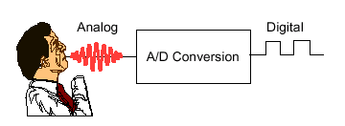
Radio Problems and digital information
GSM Transmission Process
GSM System Survey
A/D Conversion
Segmentation
Speech Coding
Channel Coding
Interleaving
Ciphering/Encryption
Burst Formatting
Modulation and Transmission

Slide 74
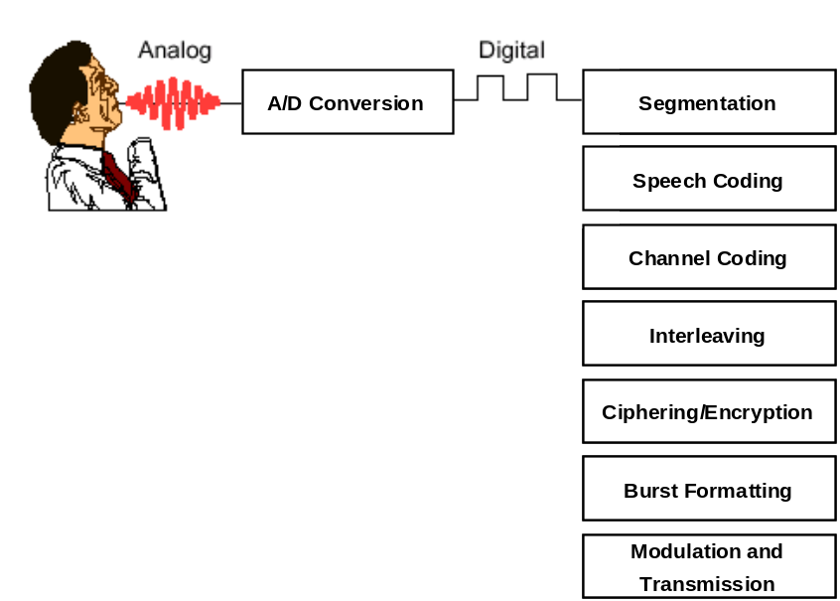
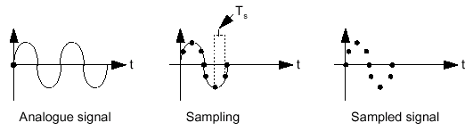
Radio Problems and digital information
Analog to Digital Conversion
GSM System Survey
Analog to digital conversion takes place in 3 steps:
1. Sampling
2. Quantization
3. Coding
1. Sampling
Telecommunication systems use Sampling rate = 8 Kbit/s

Slide 75
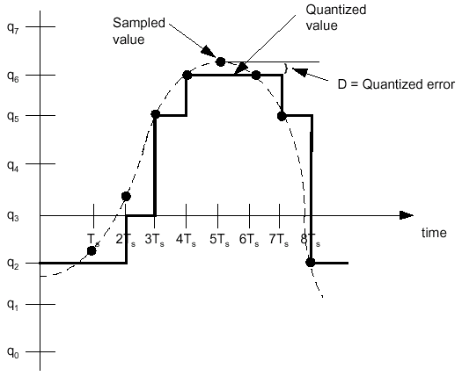
Radio Problems and digital information
Analog to Digital Conversion
GSM System Survey
2. Quantization
Within common telephony, 256 levels are used while in GSM 8192 levels are used.

Slide 76
Radio Problems and digital information
Analog to Digital Conversion
GSM System Survey
3. Coding
Coding involves converting the quantized values into binary.
Every value is represented by a binary code of 13 bits (2 ¹³ = 8192).
The output rate of the A/D Conversion process is:
8000 Samples/Sec x 13 bits/Sample = 104 Kb/s
If one frequency will be used for 8 calls, then the bit rate will be 8 x 104 kb/s = 832 kb/s this will not fit in the 200 KHz channel allocated for one frequency. Coding should be used to reduce the rate.
1 | 2 | 3 | 4 | 5 | 6 | 7 | 8 | 9 | 10 | 11 | 12 | 13 | 0 | 1 | 2 | 3 | 4 | 5 | 6 | 7 | 8 | 9 | 10

Slide 77
Radio Problems and digital information
Segmentation
GSM System Survey
160 sample in 20 ms = 1 Segment
1 | 2 | 3 | 4 | . | . | . | . |  | . | . | . | . |  | . | . | . |  | . | . | . | . |  | 160
1 | 2 | 3 | 4 | 5 | 6 | 7 | 8 | 9 | 10 | 11 | 12 | 13 | 0 | 1 | 2 | 3 | 4 | 5 | 6 | 7 | 8 | 9 | 10

Slide 78
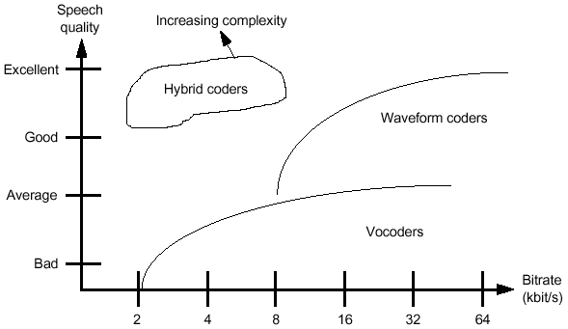
Radio Problems and digital information
GSM Speech Coding
GSM System Survey
Instead of using 13 bits per sample as in A/D conversion, GSM speech coding uses 260 bits to encode one segment.
This calculates as 260 bits / 20 ms = 13 kb/s. This provides a speech quality which is acceptable for mobile telephony and comparable with wire line PSTN phones.
Many types of speech coders are available. Some offer better speech quality, at the expense of a higher bit rate (waveform coders). Others use lower bit rates, at the expense of lower speech quality (vocoders).
The hybrid coder used by GSM provides good speech quality with a low bit rate, at the expense of speech coder complexity.

Slide 79
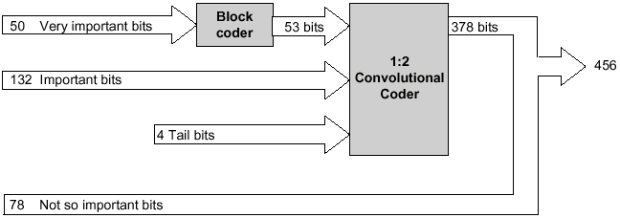
Radio Problems and digital information
Channel Coding
GSM System Survey
speech coding does not consider the
problems which may be encountered on the radio transmission path. The next stages in the transmission process, channel coding and interleaving, help to overcome these problems.
Input is 260 bits representing 1 segment

Slide 80
Radio Problems and digital information
Interleaving
GSM System Survey
1. First Level Interleaving
1 | 2 | 3 | 4 | 5 | 6 | 7 | 8
9 | 10 | 11 | 12 | 13 | 14 | 15 | 16
17 | 18 | 19 | 20 | 21 | 22 | 23 | 24
25 | 26 | 27 | 28 | .. | .. | .. | ..
.. | .. | .. | .. | .. | .. | .. | ..
.. | .. | .. | .. | .. | .. | .. | ..
.. | .. | .. | .. | .. | .. | .. | ..
.. | .. | .. | .. | .. | .. | .. | ..
 |  |  |  | 429 | 430 | 431 | 432
433 | 434 | 435 | 436 | 437 | 438 | 439 | 440
441 | 442 | 443 | 444 | 445 | 446 | 447 | 448
449 | 450 | 451 | 452 | 453 | 454 | 455 | 456
57 Bits
8 Groups

Slide 81
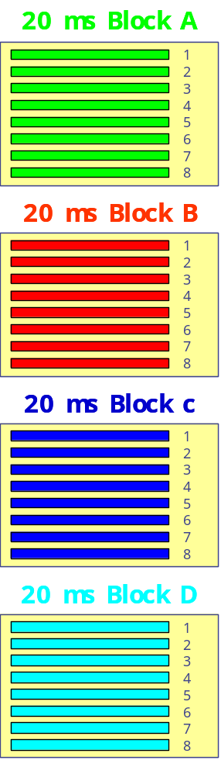
Radio Problems and digital information
Interleaving
GSM System Survey
2. Second Level Interleaving
1 A
T
5 D
2 A
T
6 D
3 A
T
7 D
4 A
T
8 D
1 B
T
5 A
2 B
T
6 A
3 B
T
7 A
4 B
T
8 A
1 C
T
5 B
2 C
T
6 B
3 C
T
7 B
4 C
T
8 B
1 D
T
5 C
2 D
T
6 C
3 D
T
7 C
4 D
T
8 C

Slide 82
Radio Problems and digital information
Ciphering and Encryption
GSM System Survey
The purpose of ciphering is to encode the
burst so that it cannot be interpreted by any other device than the intended receiver.
The ciphering algorithm in GSM is called the A5 algorithm.
It does not add bits to the burst, meaning that the input and output
to the ciphering process is the same as the input: 456 bits per 20 ms.

Slide 83
Radio Problems and digital information
Burst Formatting
GSM System Survey
Every transmission from an MS/BTS must
include some extra information such as the training sequence.
The process of burst formatting is to add these bits (along with some others such as tail bits) to the basic speech/data being sent.
In GSM, the input to burst formatting is the 456 bits received from ciphering. Burst formatting adds a total of 136 bits per block of 20 ms, bringing the overall total to 592.
Now, the 592 bits will be sent on 4 bursts, each containing 2 x 57 bits + 136 / 4 = 148 bits.
However, each time slot on a TDMA frame is 0.577 ms long.
This provides enough time for 156.25 bits to be transmitted (each bit takes 3.7 us),
The rest of the space, 8.25 bit times, is empty and is called the Guard Period (GP). This time is used to enable the MS/BTS “ramp up” and “ramp down”.

Slide 84
Radio Problems and digital information
Burst Formatting
GSM System Survey
To ramp up means to get power from
the battery/power supply for transmission.
Ramping down is performed after each transmission to ensure that the MS is not transmitting during time slots allocated to other MSs.
The output of burst formatting is a burst of 156.25 bits or 625 bits per 20 ms. When it is considered that there are 8 subscriber per TDMA frame, the overall bit rate for GSM can be calculated to be 270.9 kbits/s.
TDMA Frame
0
1
2
3
4
5
6
7
Tail Bits
Encrypted Bits
Training Sequence
Encrypted Bits
Tail Bits
Guard Period
3
57
1
26
1
57
3
8.25
156.25 bits in 577 u Sec

Slide 85
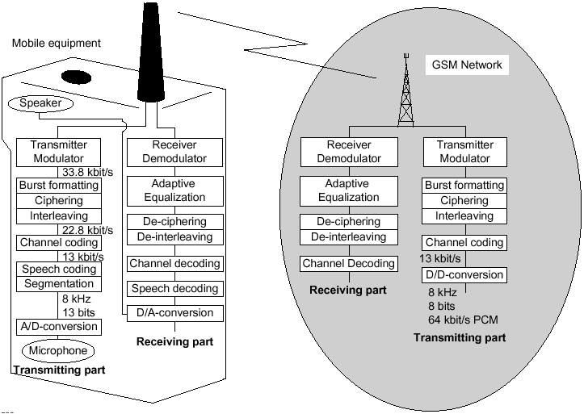
Radio Problems and digital information
Modulation and Transmission
GSM System Survey

Slide 86
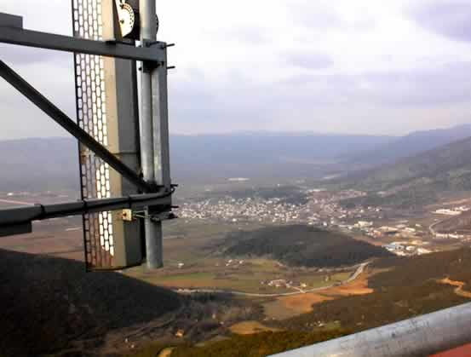
Chapter 6 : Air Interface

Slide 87
Chapter Objectives
By the End of this Chapter you will:
Know How the Physical and Logical Channels are classified
Know the different types of Traffic Channels
Know the different types of Control Channels
Know the Structure of each Control Channel
Know how control and traffic data is Mapped in the air interface
Know the terminology of different TDMA Frames

Slide 88
Air Interface
Physical Channels
GSM System Survey
GSM band is divided into 124 RF channels, and each channel is divided into 8 time slots using TDMA. These time slots are called “physical channels”.
0
1
2
3
4
5
6
7
0
1
2
3
4
5
CH 124
0
1
2
3
4
5
6
7
0
1
2
3
4
5
6
7
CH 3
0
1
2
3
4
5
6
7
0
1
2
3
4
5
6
7
CH 2
0
1
2
3
4
5
6
7
0
1
2
3
4
5
6
7
CH 1
Time

Slide 89
Air Interface
Logical Channels
GSM System Survey
A physical channel may be occupied by a traffic channel or a control channel, both of them are classified as “logical channels”.
Logical Channels
Traffic Channels
Control Channels
Half Rate
Full Rate
Common
Broadcast
Dedicated
RACH
BCCH
SDCCH
ACGCH
SCH
FACCH
PCH
FCCH
SACCH
CBCCH

Slide 90
Air Interface
Traffic Channels
GSM System Survey
Carries either encoded speech or user data up and down link between a single mobile and a single BTS.
Enhanced Full Rate = 15.1 Kbit/S
Full Rate = 13 Kbit/S
Half Rate = 6.5 Kbit/S

Slide 91
Air Interface
Broadcast Channels
GSM System Survey
From Single BTS to all the mobiles in the area
Frequency Correction Control CHannel (FCCH)
Carries information for frequency correction of the mobile
Synchronization CHannel (SCH)
Carries 2 important pieces of information
TDMA frame number (max = 2715684 )
Base station identity Code (BSIC)
Broadcast Control CHannel (BCCH)
Carries Cell specific data

Slide 92
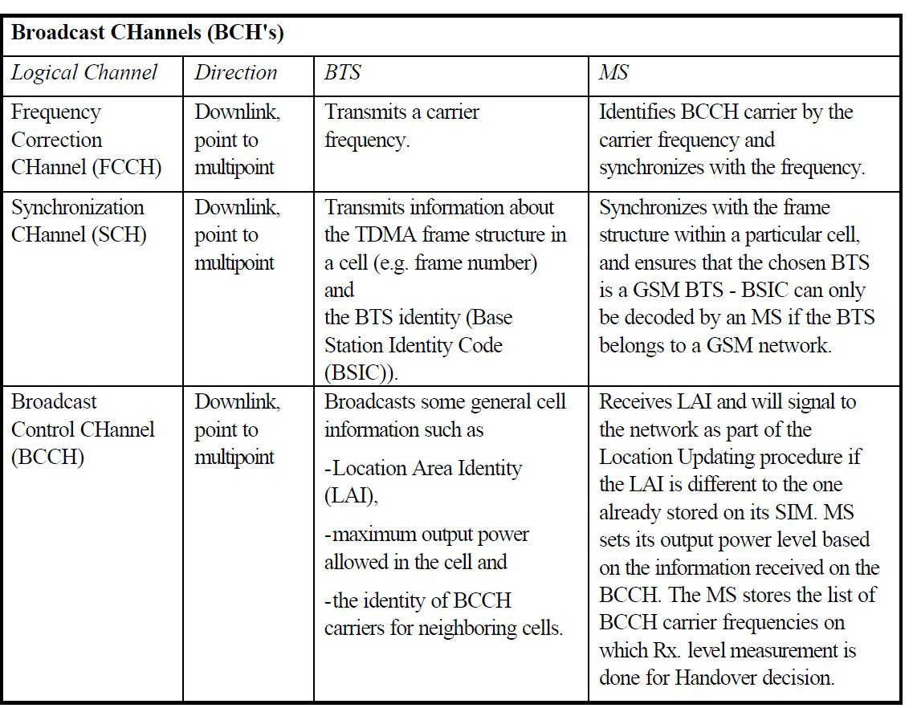

Slide 93
Air Interface
Common Control Channels
GSM System Survey
To or from a certain BTS to a single mobile
Paging CHannel (PCH)
It’s used to page (search) for a specific mobile
Random Access CHannel (RACH)
Request allocation of SDCCH
Access Grant CHannel (AGCH)
Allocate SDCCH to the mobile station.

Slide 94
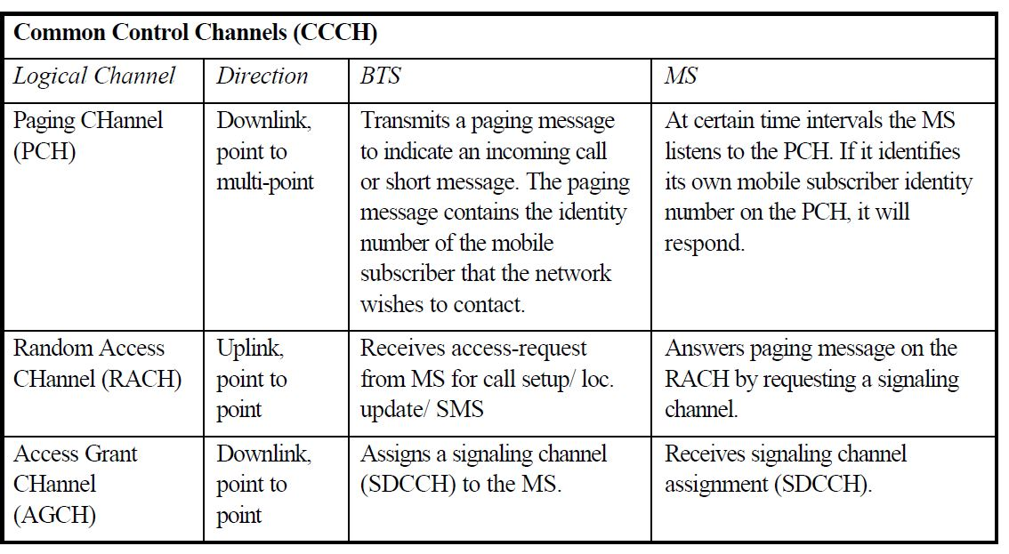

Slide 95
Air Interface
Dedicated Control Channels
GSM System Survey
Standalone Dedicated Control CHannel (SDCCH)
Carries system signaling during:
A call setup before allocating a TCH.
Registration & Authentication.
Transmission of SMS in idle mode.
MS paging Response.
Cell Broadcast Control CHannel (CBCCH)
It displays general information.
It uses one of the SDCCH channels
MS must be setup to receive this channel.

Slide 96
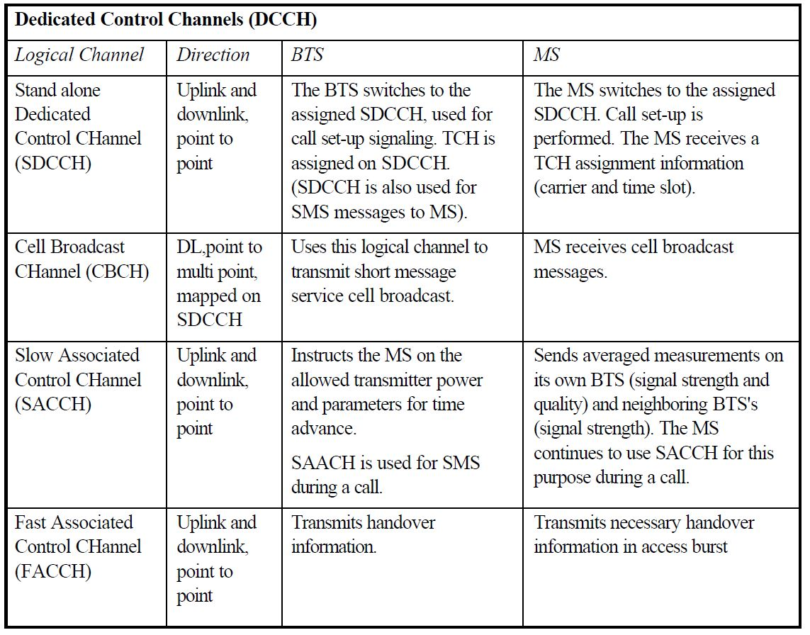

Slide 97
Air Interface
Normal Burst Structure
GSM System Survey
TDMA Frame
0 | 1 | 2 | 3 | 4 | 5 | 6 | 7
Tail Bits | Encrypted Bits |  | Training Sequence |  | Encrypted Bits | Tail Bits | Guard Period
3 | 57 | 1 | 26 | 1 | 57 | 3 | 8.25
156.25 bits in 577 u Sec
The training sequence is inserted in the middle of the burst to help the Viterbi equalizer to create the channel model
The guard period of 8.25 bits length, which is equivalent to about 30 μs, is left at the end of each burst, to prevent overlapping between consecutive bursts and to facilitate burst synchronization
The tail bits help the equalizer to determine the start and stop points of the transmitted bits. They are three bits at the beginning and at the end of the burst and they are always zeros
The subscriber speech or data is encrypted into 57 bit blocks. Each burst will contain two 57 bits blocks from two different speech segments.
One bit “stealing flag” will be added to each block to indicate whether the burst is stolen for the FACCH signaling or used as a normal traffic channel
It carries information of all logical channels except RACH, SCH and FCCH

Slide 98
Air Interface
Frequency Correction Burst Structure
GSM System Survey
TDMA Frame
0 | 1 | 2 | 3 | 4 | 5 | 6 | 7
Tail Bits | Fixed Bits | Tail Bits | Guard Period
3 | 142 | 3 | 8.25
156.25 bits in 577 u Sec
This is the one used by the channel (FCH) for frequency correction of the mobile. It consists of a long sequence of bits called the fixed bits which are all equal to zeros, leading to a constant frequency output from the GMSK modulator

Slide 99
Air Interface
Synchronization Burst Structure
GSM System Survey
TDMA Frame
0 | 1 | 2 | 3 | 4 | 5 | 6 | 7
Tail Bits | Encrypted Bits | Synchronization Sequence | Encrypted Bits | Tail Bits | Guard Period
3 | 39 | 64 | 39 | 3 | 8.25
156.25 bits in 577 u Sec
The SCH burst consists of a long synchronization sequence along with the important information being encrypted and divided into two blocks. The TDMA frame number is sent on the SCH channel, which carries also the Base station Identity code (BSIC). The TDMA frame number is used by the mobile to determine which control channels will be transmitted on that frame. It is used also as one of the input parameters to the algorithm that calculates the ciphering key Kc, which is in turn used for encryption of subscriber information transmitted on the air interface

Slide 100
Air Interface
Access Burst Structure
GSM System Survey
TDMA Frame
0 | 1 | 2 | 3 | 4 | 5 | 6 | 7
Tail Bits | Synchronization Sequence | Encrypted Bits | Tail Bits | Guard Period
8 | 41 | 36 | 3 | 68.25
156.25 bits in 577 u Sec
The Access Burst is used by the RACH channel. The mobile sends this burst when it does not know the distance to its serving BTS, which is the case when the mobile is switched on or after it makes a handover to a new cell. So this burst must be shorter in order to prevent it from overlapping with the burst on the next time slot

Slide 101
Air Interface
Dummy Burst Structure
GSM System Survey
TDMA Frame
0 | 1 | 2 | 3 | 4 | 5 | 6 | 7
Tail Bits | Encrypted Bits | Training Sequence | Encrypted Bits | Tail Bits | Guard Period
3 | 58 | 26 | 58 | 3 | 8.25
156.25 bits in 577 u Sec
The dummy burst is sent from the BTS when there is nothing else to be sent. It carries no information and it has the same structure of a normal burst with the encrypted bits replaced by a known bit pattern to the mobile

Slide 102
Air Interface
Mapping of Logical Channels onto timeslot 0 (Downlink)
GSM System Survey
Frame 1
Frame 2
Frame 3
Frame 4
Frame 5
Frame 6
Frame 7
0 | 1 | 2 | 3 | 4 | 5 | 6 | 7 | 0 | 1 | 2 | 3 | 4 | 5 | 6 | 7 | 0 | 1 | 2 | 3 | 4 | 5 | 6 | 7 | 0 | 1 | 2 | 3 | 4 | 5 | 6 | 7 | 0 | 1 | 2 | 3 | 4 | 5 | 6 | 7 | 0 | 1 | 2 | 3 | 4 | 5 | 6 | 7 | 0 | 1 | 2 | 3 | 4 | 5 | 6 | 7
F
S
B
B
B
B
C
F | S |  |  |  |  |  |  |  |  | F | S |  |  |  |  |  |  |  |  | F | S |  |  |  |  |  |  |  |  | F | S |  |  |  |  |  |  |  |  | F | S |  |  |  |  |  |  |  |  | I
B
C
C
C
C
C
C
C
C
C
 | 2 |  | 4 |  | 6 |  | 8 |  | 10 |  | 12 |  | 14 |  | 16 |  | 18 |  | 20 |  | 22 |  | 24 |  | 26 |  | 28 |  | 30 |  | 32 |  | 34 |  | 36 |  | 38 |  | 40 |  | 42 |  | 44 |  | 46 |  | 48 |  | 50
1 |  | 3 |  | 5 |  | 7 |  | 9 |  | 11 |  | 13 |  | 15 |  | 17 |  | 19 |  | 21 |  | 23 |  | 25 |  | 27 |  | 29 |  | 31 |  | 33 |  | 35 |  | 37 |  | 39 |  | 41 |  | 43 |  | 45 |  | 47 |  | 49 |  | 51
Mapping of the 51 burst consumes 51 TDMA frame
51 TDMA Frame = 1 Multi-frame

Slide 103
Air Interface
Mapping of Logical Channels onto timeslot 0 (Uplink)
GSM System Survey
Frame 1
Frame 2
Frame 3
Frame 4
Frame 5
Frame 6
Frame 7
0 | 1 | 2 | 3 | 4 | 5 | 6 | 7 | 0 | 1 | 2 | 3 | 4 | 5 | 6 | 7 | 0 | 1 | 2 | 3 | 4 | 5 | 6 | 7 | 0 | 1 | 2 | 3 | 4 | 5 | 6 | 7 | 0 | 1 | 2 | 3 | 4 | 5 | 6 | 7 | 0 | 1 | 2 | 3 | 4 | 5 | 6 | 7 | 0 | 1 | 2 | 3 | 4 | 5 | 6 | 7
R
R
R
R
R
R
R
R | R | R | R | R | R | R | R | R | R | R | R | R | R | R | R | R | R | R | R | R | R | R | R | R | R | R | R | R | R | R | R | R | R | R | R | R | R | R | R | R | R | R | R | R | R | R | R | R | R | R
Time slot 0 in the uplink direction is reserved for the RACH channel which is used by the mobiles to make random access request to the system

Slide 104
Air Interface
Mapping of Logical Channels onto timeslot 1 (Downlink)
GSM System Survey
Frame 1
Frame 2
Frame 3
Frame 4
Frame 5
Frame 6
Frame 7
0 | 1 | 2 | 3 | 4 | 5 | 6 | 7 | 0 | 1 | 2 | 3 | 4 | 5 | 6 | 7 | 0 | 1 | 2 | 3 | 4 | 5 | 6 | 7 | 0 | 1 | 2 | 3 | 4 | 5 | 6 | 7 | 0 | 1 | 2 | 3 | 4 | 5 | 6 | 7 | 0 | 1 | 2 | 3 | 4 | 5 | 6 | 7 | 0 | 1 | 2 | 3 | 4 | 5 | 6 | 7
D0
D0
D0
D0
D1
D1
D1
 |  |  |  |  |  |  |  |  |  |  |  |  |  |  |  |  |  |  |  |  |  |  |  |  |  |  |  |  |  |  |  |  |  |  |  |  |  |  |  |  |  |  |  |  |  |  |  | I | I | I
D0
D1
D2
D3
D4
D5
D6
D7
A0
A1
A2
A3
 | 2 |  | 4 |  | 6 |  | 8 |  | 10 |  | 12 |  | 14 |  | 16 |  | 18 |  | 20 |  | 22 |  | 24 |  | 26 |  | 28 |  | 30 |  | 32 |  | 34 |  | 36 |  | 38 |  | 40 |  | 42 |  | 44 |  | 46 |  | 48 |  | 50
1 |  | 3 |  | 5 |  | 7 |  | 9 |  | 11 |  | 13 |  | 15 |  | 17 |  | 19 |  | 21 |  | 23 |  | 25 |  | 27 |  | 29 |  | 31 |  | 33 |  | 35 |  | 37 |  | 39 |  | 41 |  | 43 |  | 45 |  | 47 |  | 49 |  | 51
 |  |  |  |  |  |  |  |  |  |  |  |  |  |  |  |  |  |  |  |  |  |  |  |  |  |  |  |  |  |  |  |  |  |  |  |  |  |  |  |  |  |  |  |  |  |  |  | I | I | I
D0
D1
D2
D3
D4
D5
D6
D7
A4
A5
A6
A7
52 |  |  |  |  |  |  |  |  |  |  |  |  |  |  |  |  |  |  |  |  |  |  |  |  |  |  |  |  |  |  |  |  |  |  |  |  |  |  |  |  |  |  |  |  |  |  |  | 102

Slide 105
Air Interface
Mapping of Logical Channels onto timeslot 1 (Uplink)
GSM System Survey
Frame 1
Frame 2
Frame 3
Frame 4
Frame 5
Frame 6
Frame 7
0 | 1 | 2 | 3 | 4 | 5 | 6 | 7 | 0 | 1 | 2 | 3 | 4 | 5 | 6 | 7 | 0 | 1 | 2 | 3 | 4 | 5 | 6 | 7 | 0 | 1 | 2 | 3 | 4 | 5 | 6 | 7 | 0 | 1 | 2 | 3 | 4 | 5 | 6 | 7 | 0 | 1 | 2 | 3 | 4 | 5 | 6 | 7 | 0 | 1 | 2 | 3 | 4 | 5 | 6 | 7
A5
A5
A5
A5
A6
A6
A6
 |  |  |  |  |  |  |  |  |  |  |  | I | I | I
A5
A6
A7
D0
D1
D2
D3
D4
D5
D6
D7
A0
 | 2 |  | 4 |  | 6 |  | 8 |  | 10 |  | 12 |  | 14 |  | 16 |  | 18 |  | 20 |  | 22 |  | 24 |  | 26 |  | 28 |  | 30 |  | 32 |  | 34 |  | 36 |  | 38 |  | 40 |  | 42 |  | 44 |  | 46 |  | 48 |  | 50
1 |  | 3 |  | 5 |  | 7 |  | 9 |  | 11 |  | 13 |  | 15 |  | 17 |  | 19 |  | 21 |  | 23 |  | 25 |  | 27 |  | 29 |  | 31 |  | 33 |  | 35 |  | 37 |  | 39 |  | 41 |  | 43 |  | 45 |  | 47 |  | 49 |  | 51
 |  |  |  |  |  |  |  |  |  |  |  | I | I | I
A1
A2
A3
D0
D1
D2
D3
D4
D5
D6
D7
A4
52 |  |  |  |  |  |  |  |  |  |  |  |  |  |  |  |  |  |  |  |  |  |  |  |  |  |  |  |  |  |  |  |  |  |  |  |  |  |  |  |  |  |  |  |  |  |  |  | 102

Slide 106
Air Interface
Mapping of Logical Channels onto timeslots 2 / 7
GSM System Survey
Frame 1
Frame 2
Frame 3
Frame 4
Frame 5
Frame 6
Frame 7
0 | 1 | 2 | 3 | 4 | 5 | 6 | 7 | 0 | 1 | 2 | 3 | 4 | 5 | 6 | 7 | 0 | 1 | 2 | 3 | 4 | 5 | 6 | 7 | 0 | 1 | 2 | 3 | 4 | 5 | 6 | 7 | 0 | 1 | 2 | 3 | 4 | 5 | 6 | 7 | 0 | 1 | 2 | 3 | 4 | 5 | 6 | 7 | 0 | 1 | 2 | 3 | 4 | 5 | 6 | 7
T
T
T
T
T
T
T
T | T | T | T | T | T | T | T | T | T | T | T | A | T | T | T | T | T | T | T | T | T | T | T | T | I
26 TDMA Frames
=
1 Traffic Multi-frame
 | 2 |  | 4 |  | 6 |  | 8 |  | 10 |  | 12 |  | 14 |  | 16 |  | 18 |  | 20 |  | 22 |  | 24 |  | 26
1 |  | 3 |  | 5 |  | 7 |  | 9 |  | 11 |  | 13 |  | 15 |  | 17 |  | 19 |  | 21 |  | 23 |  | 25
A (SACCH)
This contains the control signaling, an example of this is in order to change output power.

Slide 107
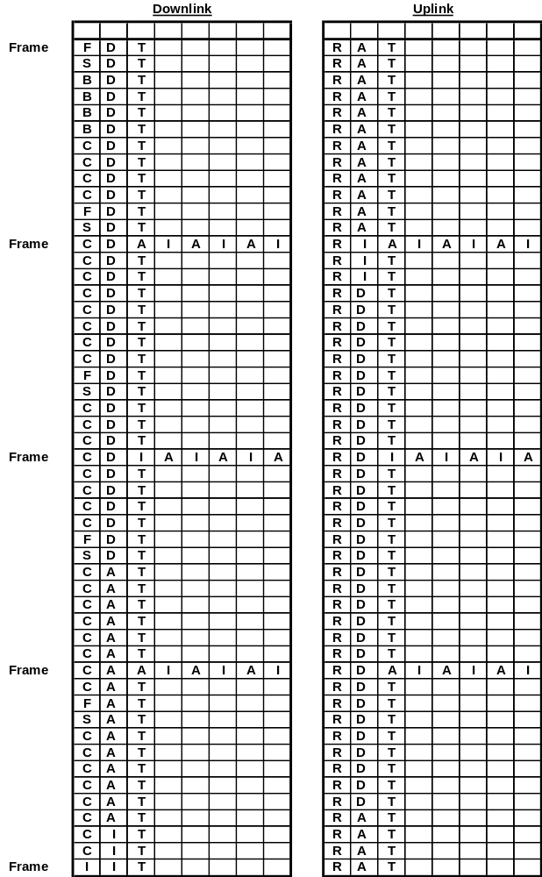
Air Interface
GSM System Survey
51 TDMA Frames = 1 BCCH Multi-frame

Slide 108
Air Interface
The Sliding Multi-frame
GSM System Survey
F | S |  |  |  |  |  |  |  |  | F | S |  |  |  |  |  |  |  |  | F | S |  |  |  |  |  |  |  |  | F | S |  |  |  |  |  |  |  |  | F | S |  |  |  |  |  |  |  |  | I
B
C
C
C
C
C
C
C
C
C
 | 2 |  | 4 |  | 6 |  | 8 |  | 10 |  | 12 |  | 14 |  | 16 |  | 18 |  | 20 |  | 22 |  | 24 |  | 26 |  | 28 |  | 30 |  | 32 |  | 34 |  | 36 |  | 38 |  | 40 |  | 42 |  | 44 |  | 46 |  | 48 |  | 50
1 |  | 3 |  | 5 |  | 7 |  | 9 |  | 11 |  | 13 |  | 15 |  | 17 |  | 19 |  | 21 |  | 23 |  | 25 |  | 27 |  | 29 |  | 31 |  | 33 |  | 35 |  | 37 |  | 39 |  | 41 |  | 43 |  | 45 |  | 47 |  | 49 |  | 51
T | T | T | T | T | T | T | T | T | T | T | T | A | T | T | T | T | T | T | T | T | T | T | T | T | I | T | T | T | T | T | T | T | T | T | T | T | T | A | T | T | T | T | T | T | T | T | T | T | T | T
I | T | T | T | T | T | T | T | T | T | T | T | T | A | T | T | T | T | T | T | T | T | T | T | T | T | I | T | T | T | T | T | T | T | T | T | T | T | T | A | T | T | T | T | T | T | T | T | T | T | T
T | I | T | T | T | T | T | T | T | T | T | T | T | T | A | T | T | T | T | T | T | T | T | T | T | T | T | I | T | T | T | T | T | T | T | T | T | T | T | T | A | T | T | T | T | T | T | T | T | T | T
T | T | I | T | T | T | T | T | T | T | T | T | T | T | T | A | T | T | T | T | T | T | T | T | T | T | T | T | I | T | T | T | T | T | T | T | T | T | T | T | T | A | T | T | T | T | T | T | T | T | T
T | T | T | I | T | T | T | T | T | T | T | T | T | T | T | T | A | T | T | T | T | T | T | T | T | T | T | T | T | I | T | T | T | T | T | T | T | T | T | T | T | T | A | T | T | T | T | T | T | T | T
T | T | T | T | I | T | T | T | T | T | T | T | T | T | T | T | T | A | T | T | T | T | T | T | T | T | T | T | T | T | I | T | T | T | T | T | T | T | T | T | T | T | T | A | T | T | T | T | T | T | T
T | T | T | T | T | I | T | T | T | T | T | T | T | T | T | T | T | T | A | T | T | T | T | T | T | T | T | T | T | T | T | I | T | T | T | T | T | T | T | T | T | T | T | T | A | T | T | T | T | T | T
T | T | T | T | T | T | I | T | T | T | T | T | T | T | T | T | T | T | T | A | T | T | T | T | T | T | T | T | T | T | T | T | I | T | T | T | T | T | T | T | T | T | T | T | T | A | T | T | T | T | T

Slide 109
Air Interface
Traffic Channel Offset
GSM System Survey
Frame 1
Frame 2
Frame 3
Frame 4
Frame 5
Frame 6
0 | 1 | 2 | 3 | 4 | 5 | 6 | 7 | 0 | 1 | 2 | 3 | 4 | 5 | 6 | 7 | 0 | 1 | 2 | 3 | 4 | 5 | 6 | 7 | 0 | 1 | 2 | 3 | 4 | 5 | 6 | 7 | 0 | 1 | 2 | 3 | 4 | 5 | 6 | 7 | 0 | 1 | 2 | 3 | 4 | 5 | 6 | 7
Offset
0 | 1 | 2 | 3 | 4 | 5 | 6 | 7 | 0 | 1 | 2 | 3 | 4 | 5 | 6 | 7 | 0 | 1 | 2 | 3 | 4 | 5 | 6 | 7 | 0 | 1 | 2 | 3 | 4 | 5 | 6 | 7 | 0 | 1 | 2 | 3 | 4 | 5 | 6 | 7 | 0 | 1 | 2 | 3 | 4 | 5 | 6 | 7
Frame 1
Frame 2
Frame 3
Frame 4
Frame 5
Frame 6

Slide 110
Air Interface
1 Hyper frame = 2048 Super frames = 2,715,648 TDMA Frames = 3hrs 28 min and 53.76 s
GSM System Survey
Hyper Frame
2
1 | 2 | e.g. BCCH | 2048
1 | 2 | e.g. TCH | 51
1 Super frame = 51 TCH Multi frames
2
1
1 Super frame = 26 BCCH Multi frames
1 | e.g. BCCH | 26
1 TCH Multi frame = 26 TDMA Frames
1 BCCH Multi frame = 51 TDMA Frames
2
1
1 | 2 | e.g. TCH | 26
1 | 2 | e.g. BCCH | 51
0 | 1 | 2 | 3 | 4 | 5 | 6 | 7
Structure
of TDMA
Frames
3 | 57 | 1 | 26 | 1 | 57 | 3 | 8.25
Normal burst
156.25 bits in 577 m Sec

Slide 111
Air Interface
Scan RF Channel and measure signal Strength for 3 – 5 sec
GSM System Survey
Tune to the RF channel with the highest received average signal strength
Measurement in idle mode
Determine if it is a BCCH carrier by searching for frequency correction bursts
Tune to the RF Channel with the highest
signal strength not already used
Is it
a BCCH carrier?
No
Yes
The MS shall attempt to synchronize to this carrier and read BCCH info
No
Does the
carrier belong to the
wanted PLMN
Yes
Is the cell
Barred for
access ?
Yes
C1 ( Path Loss Criterion Parameter) is a parameter used to make sure that the MS camps on the cell with the highest probability of successful communication on the uplink and downlink
No
No
Is C1>=0?
Yes
Camp on this cell

Slide 112
Air Interface
Measurement in active mode
GSM System Survey
Frame 23
Frame 24
Frame 25
Frame 26
Frame 27
Frame 28
0 | 1 | 2 | 3 | 4 | 5 | 6 | 7 | 0 | 1 | 2 | 3 | 4 | 5 | 6 | 7 | 0 | 1 | 2 | 3 | 4 | 5 | 6 | 7 | 0 | 1 | 2 | 3 | 4 | 5 | 6 | 7 | 0 | 1 | 2 | 3 | 4 | 5 | 6 | 7 | 0 | 1 | 2 | 3 | 4 | 5 | 6 | 7
Offset
0 | 1 | 2 | 3 | 4 | 5 | 6 | 7 | 0 | 1 | 2 | 3 | 4 | 5 | 6 | 7 | 0 | 1 | 2 | 3 | 4 | 5 | 6 | 7 | 0 | 1 | 2 | 3 | 4 | 5 | 6 | 7 | 0 | 1 | 2 | 3 | 4 | 5 | 6 | 7 | 0 | 1 | 2 | 3 | 4 | 5 | 6 | 7
Frame 23
Frame 24
Frame 25
Frame 26
Frame 27
Frame 28
The mobile is informed on the SACCH channel which BCCH frequencies to be measured.
The mobile will try to measure the signal strength of these carriers one by one during the time between transmission and reception of the allocated traffic channel: the mobile transmits, measures and then receives, and so on.
To make sure that the measured carriers do not belong to co-channel cells, the mobile will have to check the identity of the adjacent cells by reading the BSIC value sent on the SCH of each cell. This will take place during the idle frame number 26.
The signal strength of the serving cell is measured during reception of the allocated traffic channel. Then the mobile will make a list of the strongest six carriers and their BSIC values along with the signal strength of its cell, and reports this list to the BSC via the uplink SACCH channel which is repeated once every 26 frames.

Slide 113
Questions ?

Slide 114

Chapter 7 : Traffic Cases
Communicate Anywhere

Slide 115
Chapter Objectives
Traffic Cases
GSM System Survey
By the End of this Chapter you will:
Know How the Mobile Terminating call is done
Know how the PLMN Coverage area is divided ( MSC Coverage Areas & Location Areas )
Know the different types of Location Updates
Know the different types of Handover Procedures
Know How the Mobile Originating call is done
Know the different Traffic Cases a Roamer can have

Slide 116
Traffic Cases
Location Update
GSM System Survey
Why do we need to update our location data ?
Actually, the location update process is invited in aim to exactly identify your location within the network so that any incoming call goes directly to the called subscriber.
To fulfill this aim, one can say that we may update the system with the cell ID each time the subscriber changes his serving cell.
The MSC/VLR will now know the exact cell you are roaming in.
This will result in a huge amount of location update messages.
An extreme is never to make a location update and to be paged in all the network. This will cause huge amount of paging messages.
Do you have a compromising solution ?

Slide 117
Traffic Cases
Location Area
GSM System Survey
Location area is a part of the MSC/VLR coverage area. Each group of adjacent cells is assigned a universal unique location area identity.
The mobile subscriber is only required to update the network with its new location every time it changes its Location Area.
Introducing the concept of Location area enables us to make an approximate estimation of your location.

Slide 118
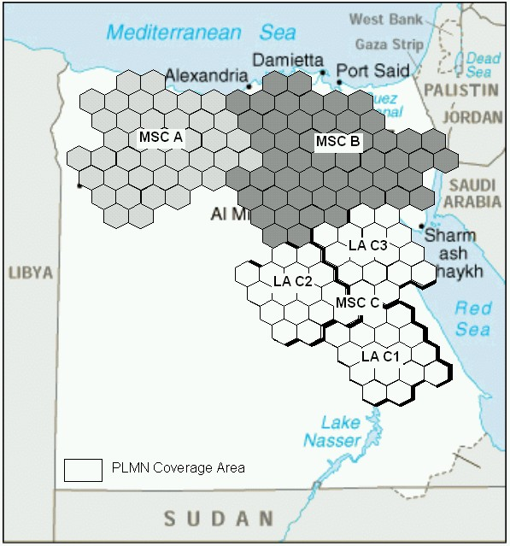
Traffic Cases
MSC Coverage Area
GSM System Survey
LA
1
LA
3
MSC
LA
2
LA
4

Slide 119
Traffic Cases
Location Area Identity (LAI)
GSM System Survey
602
MCC
02
MNC
1607
LAC
Vodafone Egypt LAI
MCC : Mobile Country Code
MNC : Mobile Network Code
LAC : Location Area Code

Slide 120
Traffic Cases
Cell Global Identity (CGI)
GSM System Survey
602
MCC
02
MNC
1607
LAC
781
CID
Vodafone Egypt CGI
MCC : Mobile Country Code
MNC : Mobile Network Code
LAC : Location Area Code
CID : Cell ID

Slide 121
Traffic Cases
Types of Location Update
GSM System Survey
1. Normal Location update within same MSC/VLR service area
2. Normal Location update between 2 different MSC/VLR service areas
3. IMSI attach/detach
4. Periodic Location Update

Slide 122
Traffic Cases
Normal Location within the same MSC/VLR Service area
GSM System Survey
4
Updates
LA Record
The Mobile sends an allocation request message to the BTS
MSC/VLR
2. The BTS responds with the allocation message
3. The mobile sends a location update request message with its IMSI to the MSC/VLR
BSC
4. The MSC/VLR updates the location
information and sends a Location Update
confirmation message

Slide 123
Traffic Cases
Normal Location Update between 2 different MSC/VLR service areas
GSM System Survey
VLR Address
=
New MSC
HLR
VLR Address
=
Old MSC
1. The mobile sends a location update request to the MSC.
IMSI to MGT
translation
2. The new MSC/VLR receives the IMSI and conclude the MGT.
3. The MSC/VLR sends a subscriber
information request with the IMSI
to the proper HLR
Old MSC/VLR
New MSC/VLR
4. The HLR stores the address of
the new MSC/VLR
5. The HLR sends the data to the
new MSC/VLR and it is kept there
Old BSC
NEW BSC
6. The HLR sends a location
cancellation message to the old
MSC/VLR to remove the data
LA 2
7. The new MSC/VLR sends a location
updating confirmation message to
the mobile
LA 1

Slide 124
Traffic Cases
IMSI Detach
GSM System Survey
1. At power off, the MS asks for a signaling channel.
2. The MS uses this signaling channel to send the IMSI detach message to the MSC/VLR.
3. In the VLR, an IMSI detach flag is set for the subscriber. This is used to reject incoming calls to the MS.

Slide 125
Traffic Cases
IMSI Attach
GSM System Survey
IMSI attach is a complement to the IMSI detach procedure. It is used by the mobile subscriber to inform the network that it has re-entered an active state and is still in the same location area. If the MS changes location area while being switched off, a normal location update takes place.
1. The MS requests a signaling channel.
2. The MSC/VLR receives the IMSI attach message from the MS.
3. The MSC/VLR sets the IMSI attach in the VLR. The mobile is now ready for normal call handling.
4. The VLR returns an acknowledgment to the MS.
1
BSC
MSC/VLR
2
3
4

Slide 126
Traffic Cases
Periodic Location Update
GSM System Survey
Periodic location update is a routine task performed by the network if the MS doesn’t make any location update ( any of the previous 4 types) during a predefined period.
If the MS doesn’t respond to this periodic location update, it will be marked as implicitly detached. ( Temporarily out of service )

Slide 127
Traffic Cases
Handover
GSM System Survey
Handover is to keep continuity of the call when the subscriber is roaming along the network moving from one cell to another and moving between different nodes in the network.
During call, the MS is continuously measuring transmission quality of neighboring cells and reports this results to the BSC through the BTS.
The BSC, being responsible on supervising the cells, is responsible of handover initiation.
Good neighbor relations between cells is an important factor in keeping the network performance in the accepted level.

Slide 128
Traffic Cases
Types of Handover
GSM System Survey
1. Intra BSC Handover:
When the cell to which the call will be handed over belongs to the same BSC of the serving cell.
2. Inter BSC / Intra MSC Handover:
When the cell to which the call will be handed over belongs to the different BSCs but to the same serving MSC.
3. Inter MSC
When the cell to which the call will be handed over belongs to the different BSC and different MSC.

Slide 129
Traffic Cases
Intra BSC Handover
GSM System Survey
BSC
The BSC decides from the power measurement reports that the call must be handed over to another cell
2. The BSC checks for an vacant TCH in the
new cell and orders this cell to activate the TCH
7
8
2
3. The BSC orders the serving cell to send
a message to the MS telling the information
of new TCH
Serving Cell
3
4
New Cell
4. The MS tunes to the new frequency and
Sends handover access burst
6
5. The new cell detects the handover burst
and sends information about the suitable
timing advance to the MS
5
6. The MS sends a HO complete message to the new cell
7. The new cell sends a message to the BSC that the handover is successful
8. The BSC orders the old Cell to release the TCH

Slide 130
Traffic Cases
Inter BSC /Intra MSC Handover
GSM System Survey
MSC/VLR
Old BSC
New BSC

Slide 131
Traffic Cases
Inter MSC Handover
GSM System Survey
Old MSC
New MSC
Old BSC
New BSC

Slide 132

Traffic Cases
Inter MSC Handover
GSM System Survey
Old MSC
New MSC
GMSC
PSTN
Old BSC
New BSC

Slide 133


Traffic Cases
Mobile Originated Call
GSM System Survey
1. The mobile sends a call request along with its IMSI to its serving MSC/VLR which will mark the mobile as busy.
2. Authentication is performed by the MSC to verify the mobile access to the network, and then ciphering is initiated in order to protect the mobile call on the radio path.
3. The mobile sends a call setup message to the MSC with information about the call type, services required and the dialed number.
4. MSC checks the categories of the mobile subscriber to verify that he is authorized to use the required services, and then a link is established between the MSC and BSC.
5. BSC checks the mobile serving BTS for an idle traffic channel and then orders that BTS to seize this channel for a call.
6. The BSC informs the MSC when the traffic channel assignment is complete, and then the MSC/VLR starts to analyze the dialed number and sets up a connection to the called subscriber.
PSTN
MSC
BSC

Slide 134


Traffic Cases
Mobile Terminating call
GSM System Survey
1
HLR
3
PSTN
5
2
6
4
GMSC
7
MSC
BSC
8
9

Slide 135

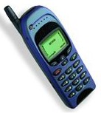
Roaming: Location Update
Traffic Cases
GSM System Survey
IMSI
60202..
Is a roaming agreement present ?
MSC/VLR
Copy of the HLR Profile will
be stored in Stock. VLR
Is roaming and Int.
calls allowed ?
Detached
Roaming & Int.
Allowed
Attached
VLR ADD=
Stock. Airport
Roaming & Int.
Allowed
Attached
VLR ADD=
Egypt Airport
Roaming & Int.
Allowed
HLR

Slide 136
Traffic Cases
Roaming: Call to HPLMN
GSM System Survey
MSISDN
+2010….
MSC/VLR
Originating Leg
Terminating Leg
Attached
VLR ADD=
xyz
HLR
GWMSC

Slide 137
Traffic Cases
Roaming: Call from HPLMN
GSM System Survey
MSC/VLR
Roaming Call Forwarding Leg
Originating Leg
Attached
VLR ADD=
Stock. Airport
Roaming & Int.
Allowed
MSISDN
010…
HLR
GWMSC

Slide 138
Traffic Cases
Roaming: Call from another Roamer
GSM System Survey
MSISDN
+2010….
MSC/VLR
A
MSC/VLR
B
Roaming Call
Forwarding Leg
Originating Leg
Attached
VLR ADD=
Stock. B
Roaming & Int.
Allowed
HLR
GWMSC

Slide 139
Traffic Cases
Roaming: Call to The visited PLMN
GSM System Survey
MSISDN
+46…
MSC/VLR
A
MSC/VLR
B
Originating Leg
STCK.
HLR
Terminating Leg
STCK.
GWMSC
HLR
GWMSC

Slide 140
Questions ?
GSM System Survey

Slide 141

Chapter 8 : GSM Services
What else other than voice?

Slide 142
Chapter Objectives
GSM Services
GSM System Survey
By the End of this Chapter you will:
Know how do Fax and data calls take place
Know how does SMS is sent and received
Know how the call of a Prepaid subscriber takes place

Slide 143
GSM Services
Introduction
GSM System Survey
Examples of GSM non-Speech services
Fax calls
Data calls
Short messages service (SMS)
Conclusion GSM is a telecommunication network rather than a telephony network.

Slide 144
GSM Services
Fax and data Calls
GSM System Survey
Supported by :
PSTN
ISDN
GSM
The receiving node must know:
What is the service requested ? e.g.. (speech, fax or data)
How will the service be performed ? E.g.. (bit rate)

Slide 145
GSM Services
Fax and data Calls
GSM System Survey
Why
do we have additional MSISDN for the same
subscriber to be able to receive fax & data calls?
Information sent at call setup from ISDN or GSM on “how” the service will be performed, is called Bearer Capabilities (BC).
ISDN and GSM have different transmission requirements and different coding schemes, so they have different bearer capabilities referred to as ISDN-BC and GSM-BC.
PSTN can not provide this type of information during call setup, so it can not distinguish between a telephony call and a fax or data call.
An Additional MSISDN (AMSISDN) will be allocated to a mobile subscriber who has the service of receiving fax or data calls.

Slide 146
GSM Services
Fax and data Calls
GSM System Survey
For an MSC to be able to handle fax or data calls, it should be provided with a Data Transmission Interface (DTI) which is used for :
rate adaptation.
Protocol conversion.
Providing modems.
such that Fax , Data calls are to be established to/from mobile subscribers.
Standard Bit Rate in GSM = 9.6 KB/S
This rate can be increased into 14.4 KB/S
The High Speed Circuit Switched Data (HSCSD) uses 4 time slots to perform a data call thus increasing the rate into 57.6 KB/S

Slide 147

GSM Services
Fax and data Calls
GSM System Survey
Fax from PSTN
HLR
AMSISDN IMSI
AMSISDN BC
AMSISDN
PSTN
AMSISDN
GWMSC
MSC/VLR
DTI

Slide 148
GSM Services
Fax and data Calls
GSM System Survey
GSM fax call
PSTN
MSC
DTI

Slide 149
GSM Services
Future Enhancements
GSM System Survey
GPRS General Packet Radio Services
( Up to 171 Kbit/sec)
EDGE Enhanced Data Rates for GSM Evolution
( Up to 48 Kbit/sec per channel)
UMTS Universal Mobile telecommunication System (Up to 2 MB)

Slide 150
GSM Services
GSM Evolution
GSM System Survey
UMTS
capable systems
Functionality
& capabilities
WCDMA
2 Mbps
EDGE/IS-136
384 kbps
GPRS
115 kbps
HSCSD
57.6 kbps
Packet Switched
Circuit data
<9.6 kbps
Circuit Switched
Speech
Time
1997
1998
1999
2000
2001
2002
General Packet Radio Services
Enhanced Data Rate for GSM Evolution
Universal Mobile Telecommunication System
High Speed Circuit Switching Data
Wideband Code Division Multiple Access

Slide 151
GSM Services
Short Message Service
GSM System Survey
The Short Message Service (SMS) allows a mobile subscriber to send and
receive text messages composed of 160 characters at most.
The short messages sent or received are handled by the Short Message
Service Center ( SMSC ), which consists of three parts :
Service Center (SC)
SMS GMSC (SMS-GMSC)
SMS inter-working MSC ( SMS-IWMSC)

Slide 152
GSM Services
Short Message Service
GSM System Survey
Service Center
Handles the delivery of short messages to/from Short Message Entities (SME), which can be any originator or receiver of short messages such as mobile, fax, … etc.
Stores the short messages.
Create billing files.
Monitors system events and alarms.
SMS-GMSC
Interrogates the HLR to determine the location of a mobile subscriber.
Forwards the short message to a mobile subscriber via its serving MSC.
SMS-IWMSC
Receives the mobile originated short message from any MSC in the network.
Receives an alert message from the HLR to inform the SC that a mobile subscriber who was absent during a previous short message delivery attempt is reachable again.

Slide 153
GSM Services
Mobile Originated SMS
GSM System Survey
SC
SMS - IWMSC
SMS - GMSC
MSC1
HLR
MSC2
MO
MT

Slide 154
GSM Services
Unsuccessful Message Transfer
GSM System Survey
SC
SMS - IWMSC
SMS - GMSC
Pending Message Flag
MSC1
HLR
MSC2
Waiting Message Data
MO
MT

Slide 155
GSM Services
The Mobile is present once more
GSM System Survey
SC
Alert:
The MS is present
SMS - IWMSC
SMS - GMSC
Alert:
The MS is present
Alert:
The MS is present
MSC1
HLR
MSC3
Attach
Alert :
The MS is present
MO
MT

Slide 156
GSM Services
Advanced GSM Services
GSM System Survey
WAP Wireless Applications Protocol
CAMEL Customized Application of Mobile Enhanced Logic

Slide 157

GSM Services
The Pre-payment system
GSM System Survey
A pre-paid
subscriber
MSC
IVR
858
858 Charging
868
Balance inquiry 868
SDP
PPAS
IVR :Interactive Voice Recognition
PPAS:Prepayment Administration system.
SDP :Service Data Point.

Slide 158
GSM Services
Pre-payment Originating call
GSM System Survey
A pre-paid
subscriber
MSC 0
Oick-3
Oick-6
SDP1
Oick-3
SCP2
satellite
nodes
Oick
HLR
SDP2
Oick-2
SCP3
MSC 13
SDP1
Oick-5
Oick-2
Oick-6
Oick-5

Slide 159
Questions ?
GSM System Survey

Slide 160

Thank You For your time

